Slide 1
Airline Mangement System
DT-22002 Neha Laeeq
DT-22008 Syeda Fatima
DT-22037 Shayan
DT-22041 Ahmed Hasan

Slide 2
Contents
Introduction/Abstract
ERD
Normalization
SQL queries and outputs

Slide 3
Abstract
Project Overview:
Comprehensive airline management system
Utilizes LibSQL and Drizzle-ORM library
Operational Aspects Managed:
Airlines, Airports, Aircrafts, Routes, Flights
Pilots, Crew members, Passengers, Tickets
Maintenance, Incidents
Database Schema:
Designed with normalization principles.
Ensures data integrity and efficiency
Core Tables:
Airlines, Airports, Aircrafts, Routes, Flights
Pilots, Crew members, Passengers, Tickets
Maintenance, Incidents

Slide 4
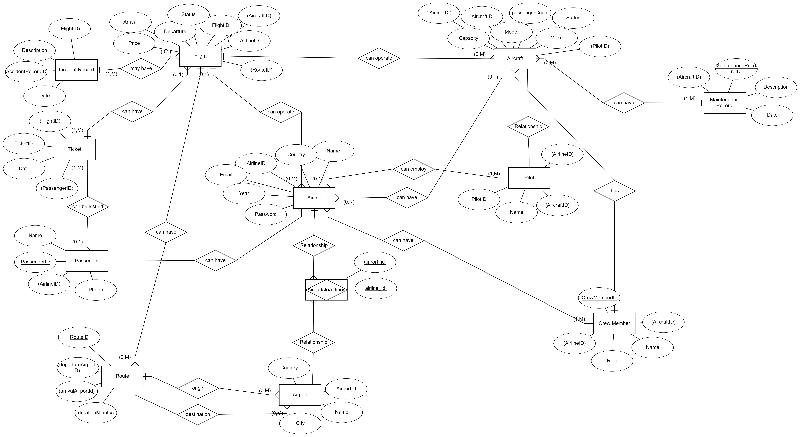
Entity Relationship Diagram (ERD)

Slide 5
Abstract
Table Definitions:
Essential fields and constraints
Primary keys, unique constraints, foreign keys
Relationships:
One-to-one, One-to-many, Many-to-many
Join table for airports and airlines
Technical Implementation:
TypeScript for type safety and maintainability
Drizzle-ORM with LibSQL integration
Use of default values, timestamps, UUIDs

Slide 6
Unnormalized Form
This table has multiple issues:
Repeating groups (e.g., CrewMemberNames and PassengerNames contain multiple values).
Redundant information (e.g., airline details are repeated for each flight).

Slide 7
Normalized Form
1st NF:
Now each cell contains only a single value, and there are no repeating groups. However, redundancy and other anomalies still exist.

Slide 8

Normalized Form
2nd NF:
Flights Table:
Airlines Table:
To achieve 2NF, we must remove partial dependencies. Since our current table uses FlightID as the primary key, we should ensure that all non-key attributes are fully functionally dependent on FlightID.

Slide 9

Normalized Form
3rd NF:
Airline Table:
Flights Table:
To achieve 3NF, we must remove transitive dependencies. That is, non-key attributes should not depend on other non-key attributes.

Slide 10
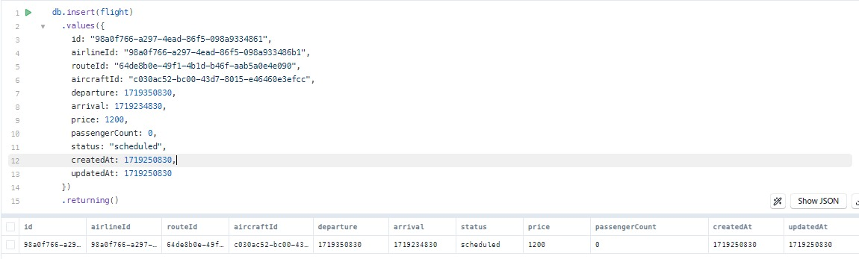
DML Queries
Insert Flight Table:

Slide 11
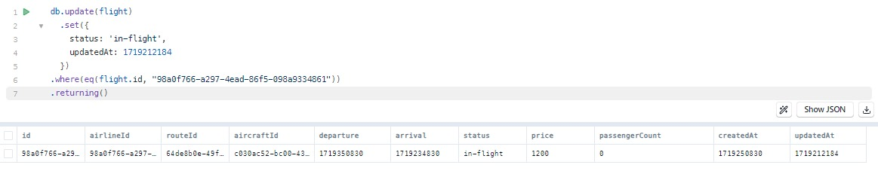
DML Queries
Update Flight Table:

Slide 12
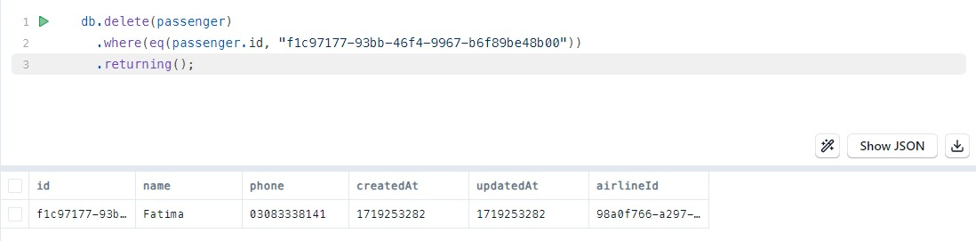
DML Queries
Delete from Passengers Table:

Slide 13
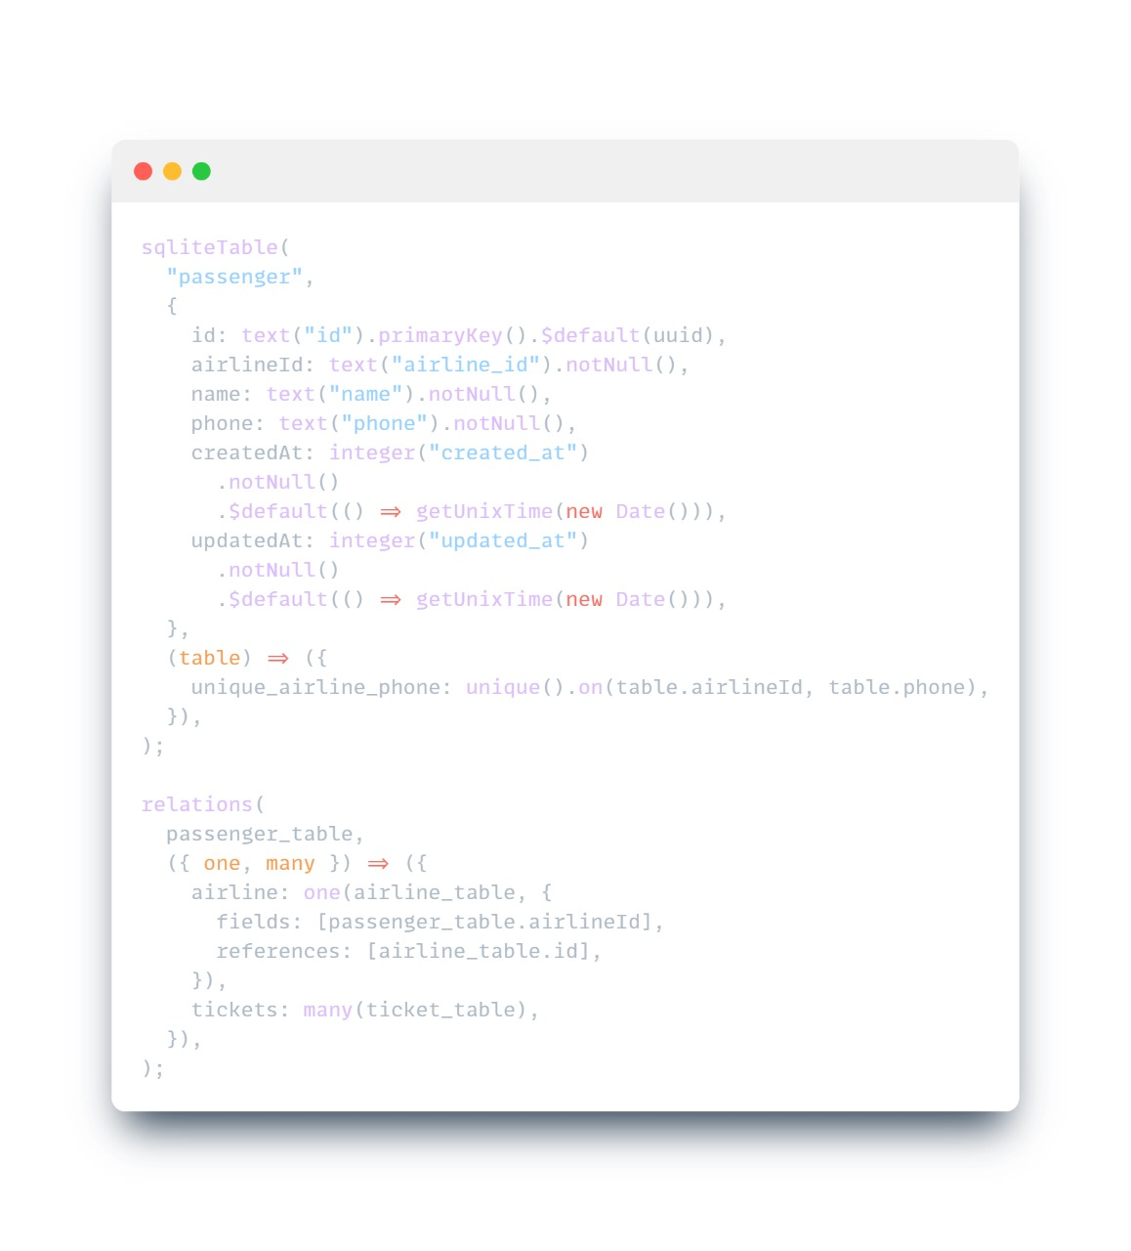
DDL Queries
Passengers Table:

Slide 14
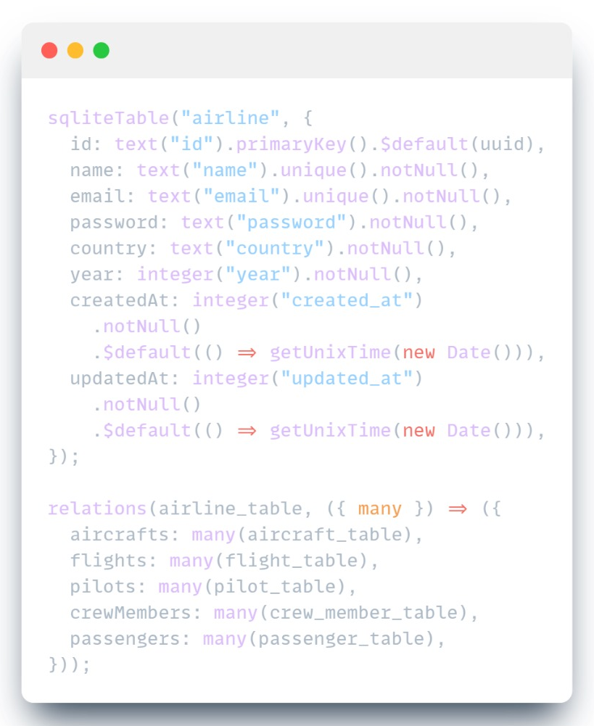
DDL Queries
Airline Table:

Slide 15
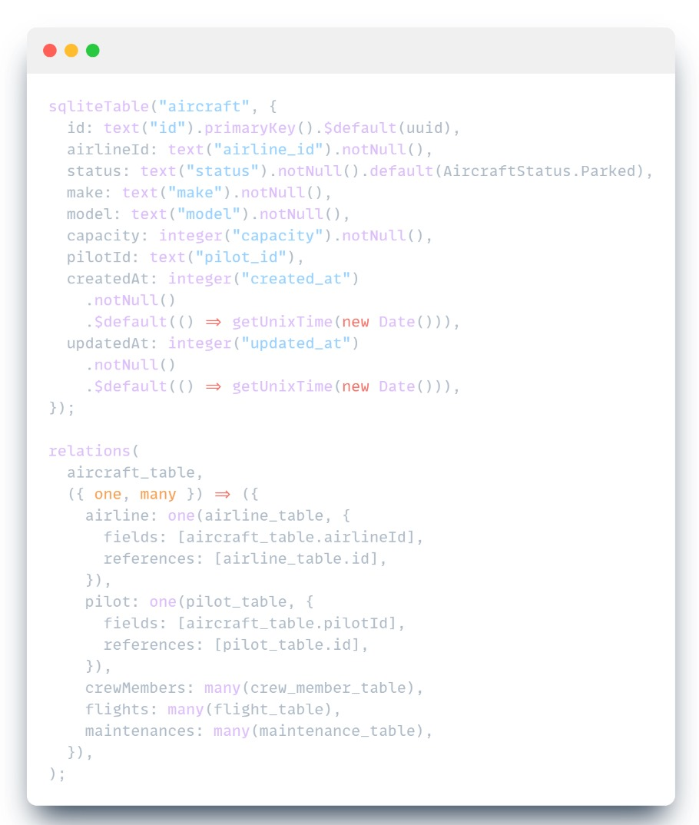
DDL Queries
Aircraft Table:

Slide 16
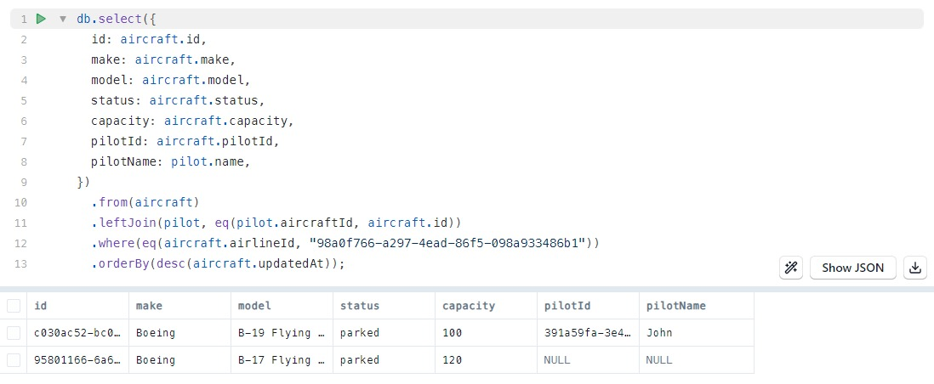
Joins Queries

Slide 17
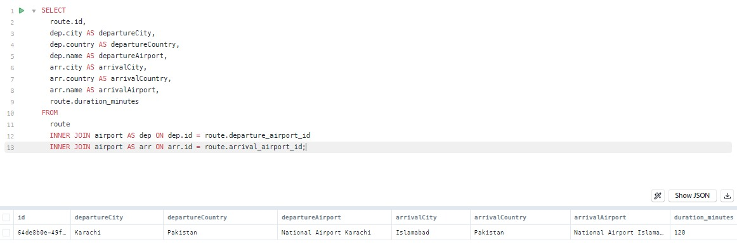
Joins Queries

Slide 18
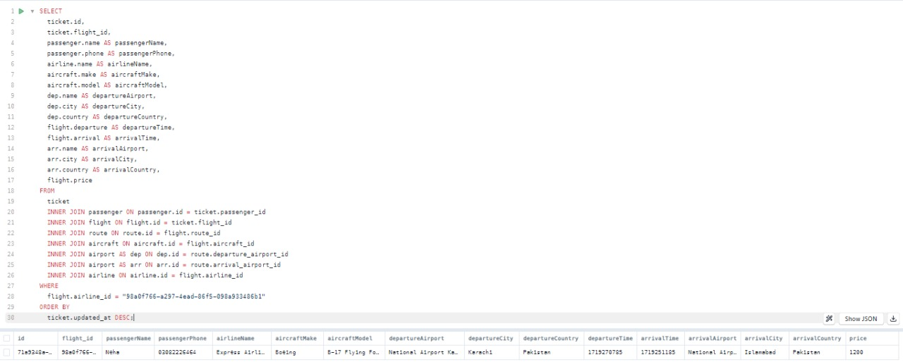
Joins Queries

Slide 19
Thank You!

